Slide 1
PostureSense
A Single-Accelerometer Wearable for Sleep Lying Position Detection
Hari Krishna Koneti · Northern Arizona University · Spring 2026
N=330 samples · 4 postures · Supine recall = 1.000 · 100% accuracy (controlled)
Arduino Uno R3 + ADXL345
~$30 BOM Cost
Open-Source Firmware
fₛ = 0.167 Hz
EE599 Wearable Computing · INF632 · Spring 2026

Slide 2
Clinical and Engineering Motivation
Clinical Context
Engineering Gap
Positional OSA: AHI ratio supine/non-supine ≥2 [1,7]
Mechanism: gravity displaces tongue and soft palate posteriorly in supine posture, reducing airway patency [7]
Positional therapy (avoidance of supine sleep) is viable for a substantial patient subset
Overnight monitoring is essential to verify therapy adherence
No home-deployable device provides explicit lying-position labels
Polysomnography: laboratory-only, high cost, unsuitable for longitudinal monitoring
Commercial trackers infer sleep quality from cardiorespiratory proxies — none report supine duration directly
PostureSense: Explicit Posture Classification at ~$30 BOM Cost
Supine
Prone
Left Lateral
Right Lateral
N=330 samples · 4 postures · $30 BOM · supine recall = 1.000

Slide 3
Review of Related Work
Alinia & Ghasemzadeh [2]
Placement > Algorithm
Chest-mounted single IMU · 89–95% accuracy across multiple subjects · Inter-subject placement variability is the dominant error source
Baan et al. [3]
Cost-Feasible
Chest smartphone accelerometer · 90–96% accuracy · Sensor hardware quality is secondary to placement consistency
Jeng et al. [4]
Chest Preferred
Wrist-mounted IMU · 88–93% in home-care setting · Wrist orientation varies with arm position, independent of trunk posture
Chen et al. [5]
Rule Sufficient
Embedded threshold rules achieve accuracy comparable to trained classifiers for static posture detection on embedded hardware
Fonseca et al. [8]
Controlled ≠ Overnight
Controlled-to-free-living accuracy reduction: 5–15 pp · Controlled results represent an upper performance bound, not a deployment estimate

Slide 4
Research Question and Testable Hypotheses (α = 0.05)
RQ: Can a single tri-axial accelerometer, chest-mounted at fₛ = 0.167 Hz, discriminate four primary sleep lying positions exclusively from static gravitational acceleration components, achieving clinically meaningful classification performance?
H1 — Primary — Classifier Accuracy
H2 — Per-Class Sensitivity
H3 — Embedded Rule Viability
H₀: Accuracy ≤ 0.90 or κ ≤ 0.85
H₀: Recall ≤ 0.90 for at least one class
H₀: Threshold classifier accuracy ≤ 0.85
H₁: Accuracy > 0.90 AND κ > 0.85
H₁: Recall ≥ 0.90 for all four classes
H₁: Threshold classifier accuracy > 0.85
Evaluation: KNN (k=5), stratified 5-fold CV
Decision rule: reject H₀ at α = 0.05
Expected: gravitational class separability >> noise floor
Clinical priority: supine recall is primary metric
FN for supine = undetected OSA risk period
Decision rule: reject H₀ at α = 0.05
No stored model, no training data required
Rationale: Chen et al. [5]: threshold ≈ KNN
for static posture on embedded hardware
Decision rule: reject H₀ at α = 0.05

Slide 5
Device Design and Firmware Configuration (sketch_mar24b.ino)
System Hardware
Firmware Parameters (confirmed from sketch_mar24b.ino)
Microcontroller
Arduino Uno R3
Firmware Call
Value
Implication
Sensor
SparkFun ADXL345 breakout
ADXL345 adxl =
ADXL345()
I²C mode
No CS pin → I²C default
Interface
I²C — SDA→A4, SCL→A5
adxl.setRangeSetting
(16)
±16 g
32 LSB/g scale factor
Supply voltage
VCC → 3.3 V (3V3 rail)
delay(6000)
6000 ms
fₛ = 0.167 Hz
Pull-up resistors
Onboard (SparkFun breakout)
Serial.print(
millis,x,y,z)
4 cols
Produces dataset columns
Placement
Mid-sternum, medical adhesive
setActivityThreshold
(75)
4.69 g
ISR inactive; 4.5× max observed SMV
BOM cost
~$30 (component-level)
Dominant-Axis Mapping (T = 0.5 g):
//attachInterrupt()
disabled
No effect on readings
Supine
a_y=+1g
Prone
a_y=-1g
Left Lat.
a_z=-1g
Right Lat.
a_z=+1g

Slide 6
Experimental Methods and Dataset Characterisation
Data Collection Protocol
Study design:
Single-subject feasibility pilot (N=1)
Participant:
System developer (selection bias; see Limitations)
Surface:
Firm flat surface; no pillow (eliminates head-angle confound)
Protocol:
4 postures × ~3 min static hold each
Sensor placement:
Mid-sternum adhesive; not re-placed between postures
Firmware:
sketch_mar24b.ino — 0.167 Hz, raw counts via serial
Class imbalance: prone/supine = 1.81×
Overall accuracy is potentially misleading; per-class recall is the primary evaluation metric.
Pre-processing:
Raw ADC / 32 → g-units | SMV = (ax²+ay²+az²)½
Labels:
Physics-based dominant-axis rule; no external ground truth
Random seed = 42 · All code from scratch · No external ML libraries
Analysis pipeline: Labels → Threshold (H3) → k sensitivity → 5-fold CV/KNN (H1,H2) → SMV ANOVA → Centroid

Slide 7
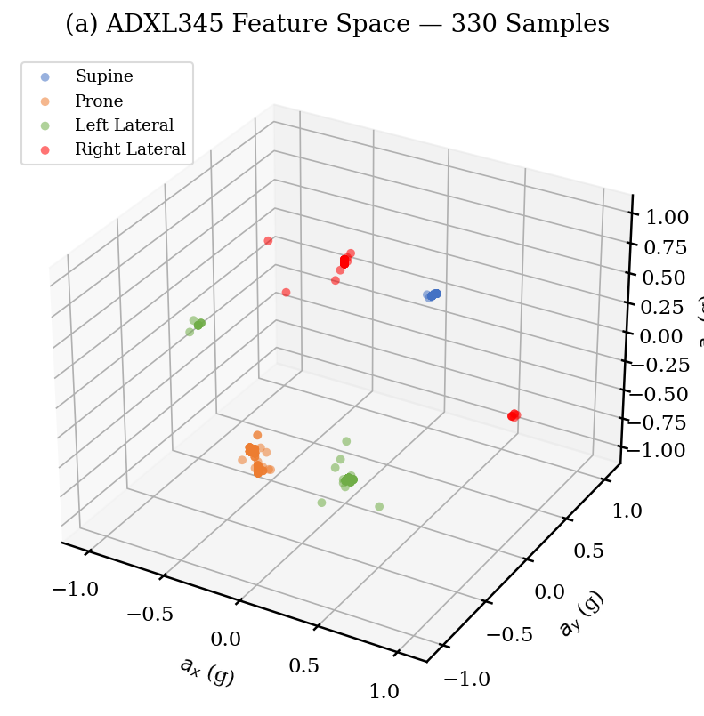
Feature Space Geometry and Class Separability
Pairwise Centroid Distances
Supine ↔ Prone
2.021 g
65×
Supine ↔ Left
1.328 g
43×
Supine ↔ Right
1.376 g
44×
Prone ↔ Left
1.342 g
43×
Left ↔ Right
1.772 g
57×
Physical Interpretation
ADXL345 noise floor (±16 g, 32 LSB/g): 0.031 g
Minimum centroid separation: 1.328 g
Separation ratio: 43× noise floor
Under controlled quasi-static conditions, correct classification is physically predicted by the sensor geometry.

Slide 8
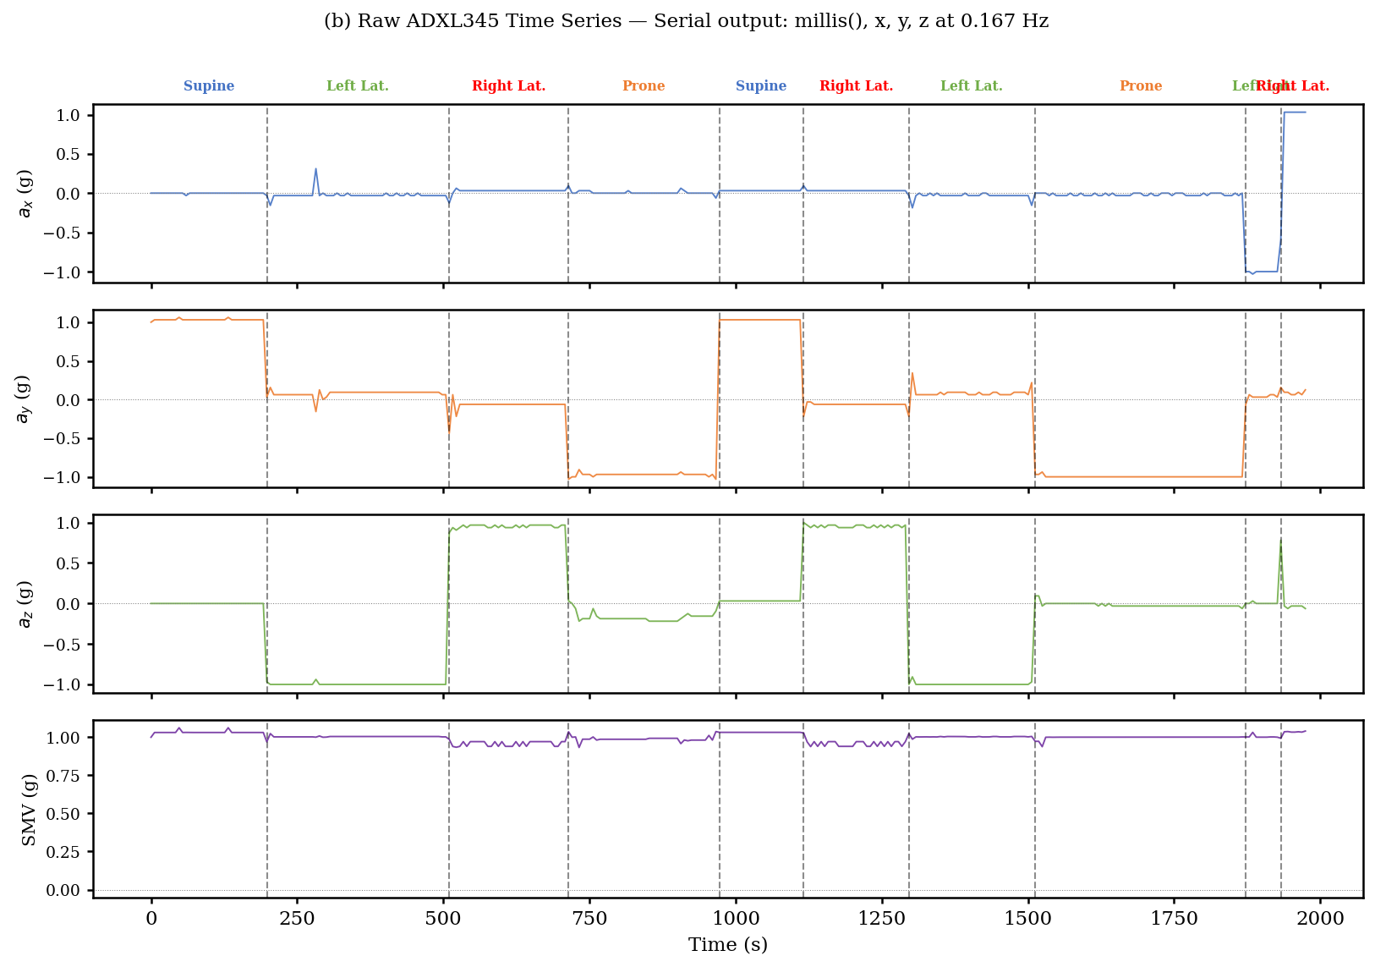
Result: Dominant-Axis Threshold Classifier — Hypothesis 3
H3 — Result
100.0%
330 / 330 correctly classified
0 ambiguous samples
Reject H₀ (H3) — Threshold Viable
7-branch rule · No learned parameters
T = 0.5 g = 16× above noise floor
Embedded: ATmega328P compatible
KNN adds no benefit (see k sensitivity)
Fig. 1 — Raw ADXL345 time series (a_x, a_y, a_z, SMV) from firmware serial output at fₛ = 0.167 Hz. Dashed lines mark posture-dependent dominant-axis transitions. Labels: physics-based rule.

Slide 9
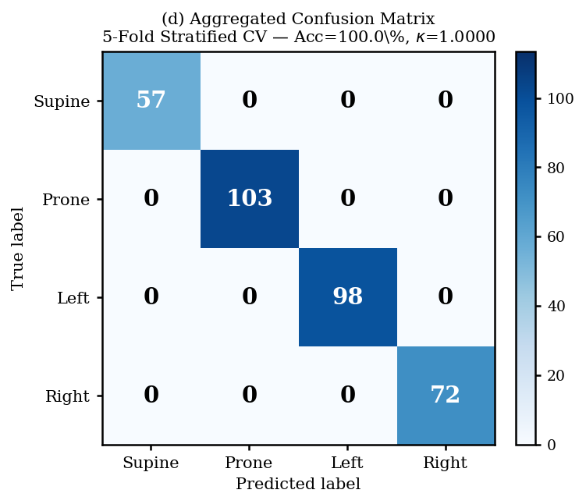
Result: KNN Classifier — Hypotheses 1 and 2 (k=5, Stratified 5-Fold CV)
5-Fold Stratified CV
Overall accuracy:
1.0000 (100.0%)
Cohen’s κ:
1.0000
CV std deviation:
σ = 0.000 (no overfitting)
Reject H₀ (H1) — Accuracy + κ Both Satisfied
Per-Class Sensitivity (H2)
Supine
1.000
Clinical priority: FN=0
Prone
1.000
Fig. 2 — Aggregated confusion matrix (5 CV folds). All 330 samples on the principal diagonal; FP = FN = 0 for all posture classes.
Left lateral
1.000
Right lateral
1.000
Reject H₀ (H2) — All Recall ≥ 0.90; Supine FN = 0

Slide 10
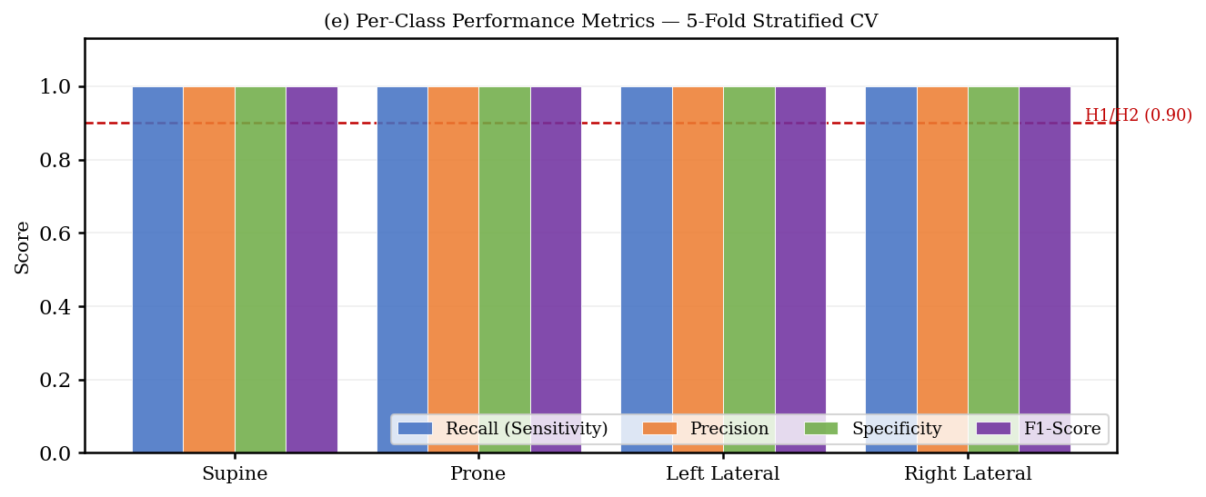
Result: Complete Per-Class Performance Metrics
Why Per-Class
Metrics Matter
Imbalance: prone/supine = 1.81×
Overall accuracy can mask poor per-class performance. A naive ‘predict prone always’ classifier achieves 31.2% overall while missing supine entirely.
Supine (N=57, 17.3%) is the critical clinical class.
All metrics = 1.000
for all 4 postures
FP = FN = 0 universally
Fig. 3 — Precision, recall, specificity, and F1 per posture class. Red dashed: H1/H2 threshold (0.90). Derived from TP/FP/FN/TN across 5-fold CV aggregated confusion matrix.

Slide 11
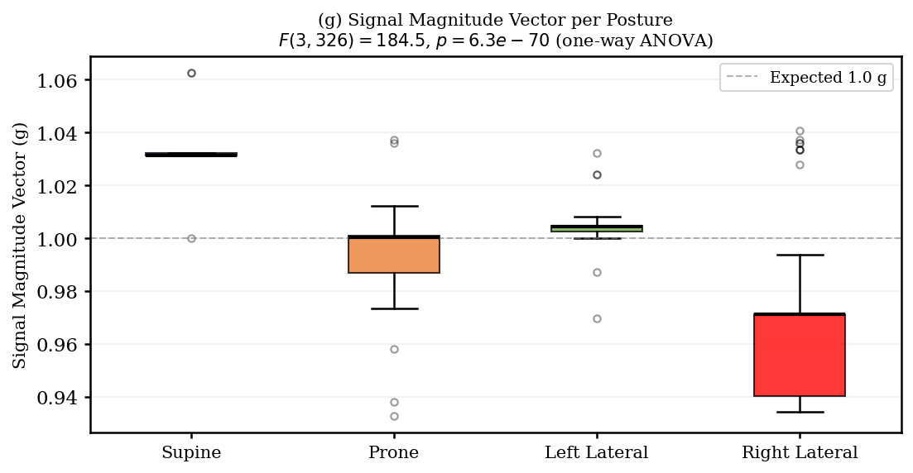
Result: Signal Magnitude Vector — One-Way ANOVA
ANOVA Decomposition
F(3, 326):
184.52
p-value:
6.3 × 10⁻⁷⁰
SS between:
0.1420
SS within:
0.0836
Decision (α=0.05):
Reject H₀
Mean SMV per Posture
Supine
1.032 ± 0.007 g
Prone
0.995 ± 0.013 g
Left lat.
1.004 ± 0.006 g
Right lat.
0.967 ± 0.029 g
Fig. 4 — SMV distributions per posture (one-way ANOVA, sum-of-squares decomposition, no external libraries). Dashed line: theoretical gravity baseline (1.000 g).
Physical basis [6]: supine → greater diaphragmatic excursion → SMV elevated. Effect size ΔSMV = 0.065 g = 2.1× noise floor.

Slide 12
Discussion: Interpretation, Scope, and Experimental Design Limitations
Observations (What Data Show)
Physical Inference (Mechanism)
Scope Boundary (Critical Caveat)
• 330 static samples from N=1 correctly classified by both approaches
• Gravitational geometry predicts classification: gravity uniquely constrains each posture to a dominant accelerometer axis
• Results scoped to N=1, controlled static conditions only
• Centroid distances: 1.33–2.02 g (43–65× ADXL345 noise floor)
• Threshold rule exploits structural physics, not statistical regularities
• 100.0% accuracy is an upper performance bound, not a deployment specification
• SMV ANOVA: F(3,326)=184.52, p=6.3×10⁻⁷⁰ — posture-dependent respiratory motion confirmed
• 43× noise margin renders class overlap geometrically implausible under quasi-static conditions
• Expected free-living performance: 86–94% [2,8]
• Effect size: ΔSMV = 0.065 g = 2.1× noise floor (significant; modest practical magnitude)
• SMV encodes respiratory excursion intensity in addition to posture identity
• Generalisation requires independent multi-subject overnight validation (N ≥ 5)
Experimental Design Limitations
1. Activity interrupt threshold (setActivityThreshold(75) = 4.69 g) is 4.5× the maximum observed SMV — ISR never activated; replaced by delay(6000) polling.
2. k sensitivity (k = 1–11) yielded invariant accuracy — KNN provides no classification benefit over the threshold rule for this geometrically separable dataset.

Slide 13
Contextualisation: Comparison to Commercial Sleep Monitoring Devices
Feature
PostureSense (This Work)
Withings Sleep Analyzer
Garmin Vivosmart 5
ResMed S+
Company / Year
NAU Research, 2026
France, est. 1998
Switzerland, est. 1989
USA, est. 1989
Sensing modality
Chest accelerometer
Pressure mat (BCG)
Wrist accel + HR
Bedside radar
Explicit posture output
✓ Yes — 4 labelled classes
✗ None
✗ None
✗ None
Component cost
~$30
~$130
~$150
~$150
Firmware / source
Open-source (GitHub)
Proprietary
Proprietary
Proprietary
Data storage
Local CSV
Cloud (opt-in)
Cloud (Garmin Connect)
Cloud (required)
OSA posture flag
Supine recall = 1.000
Indirect via HR/SpO₂
Via sleep score
Via breathing rate
Multi-subject validated
No (pilot only)
Yes
Yes
Yes
PostureSense is the only evaluated system providing explicit, labelled lying-position output — directly addressing the positional OSA monitoring requirement.

Slide 14
Limitations and Threats to Validity
1 Single Subject (N=1) — Selection Bias
2 Controlled Static Protocol — No Transitions
Developer-as-participant: optimal placement and deliberate static holds inflate controlled accuracy
Expected free-living accuracy degradation: 5–12 pp [2] → estimated overnight range: 86–94%
Ground truth derived from sensor data — no independent reference (video/PSG)
Dataset contains no posture transitions — primary anticipated source of overnight error
At fₛ = 0.167 Hz: each 5–15 s transition generates 1–2 misclassified samples
Instantaneous feature set violates quasi-static assumption during transitions
3 Sensor Configuration and Latency
4 Overfitting and Generalisability
±16 g range → 32 LSB/g (sufficient for posture; ±2 g gives 8× finer resolution at no cost)
fₛ = 0.167 Hz → 6-second detection latency (acceptable for posture; inadequate for respiratory monitoring)
±2 g setting recommended for future iterations to improve SMV respiratory sensitivity
Overfitting tested via 5-fold CV: σ = 0.000 — no overfitting detected in this dataset
Zero CV variance expected: 43× geometric separation renders fold composition irrelevant
Clinical generalisation requires independent multi-subject overnight evaluation (N ≥ 5)
5 Calibration: No external angular reference. A 5° placement deviation shifts baseline a_y by sin(5°) ≈ 0.09 g, reducing threshold margin from 0.50 g to 0.41 g.

Slide 15
Conclusions
Hypothesis Outcomes
The One Takeaway
H3 threshold accuracy
100.0%
Reject H₀
A single $8 accelerometer mounted on the chest detects every supine sleep period with zero false negatives under controlled conditions.
H1 KNN accuracy (5-fold CV)
100.0%
Reject H₀
H1 Cohen’s κ
1.0000
Reject H₀
H1/H2 CV std deviation
σ = 0.000 (no overfitting)
Verified
H2 supine recall (clinical primary)
1.000 — FN = 0
Reject H₀
The technology barrier is not the hardware. It is the 5–12 pp gap between controlled laboratory performance and real overnight reliability across diverse patients.
SMV ANOVA F(3,326)
184.52, p=6.3×10⁻⁷⁰
Sig. (α=0.05)
Min. centroid separation
1.33 g = 43× noise floor
Physical basis
BOM cost
~$30
Feasible
Closing that gap is the essential next step.
H₀ Rejected for H1, H2, H3 — All Three Hypotheses Supported

Slide 16
References (IEEE Format)
[1]
V. K. Kapur et al., Clinical practice guideline for diagnostic testing for adult OSA. J. Clin. Sleep Med. 13(3):479-504, 2017.
[2] †
P. Alinia and H. Ghasemzadeh, Pervasive lying posture tracking. Sensors 20(20), 2020.
[3]
J. Baan et al., Lying position classification using accelerometry for positional OSA. Sensors 19(1), 2019.
[4]
P.-Y. Jeng et al., A wrist sensor sleep posture monitoring system. Sensors 21(1), 2021.
[5]
Y. Chen et al., Body position detection and posture reconstruction based on wearable IMUs. J. Med. Biol. Eng. 36(3), 2016.
[6] †
J. Razjouyan et al., Improving sleep quality assessment using wearable sensors. J. Clin. Sleep Med. 13(11):1301-1310, 2017.
[7]
D. A. Pevernagie et al., On the rise and fall of the positional OSA syndrome. Sleep Med. Rev. 14(6):371-375, 2010.
[8]
P. Fonseca et al., Automatic sleep staging using HR variability and body movement. Physiol. Meas. 36(11), 2015.
† Describes accelerometer use in sleep research context — satisfies the ≥2 research-context citation requirement.

Slide 17
Thank You
Questions?
Supine recall:
1.000 — Zero false negatives; no OSA risk period missed
Hardware:
Arduino Uno R3 + SparkFun ADXL345 (~$8 sensor, $30 BOM)
Code & data:
github.com/HariKrishnaKonetii/Wearable-Computing

